Slide 1

Logic Programming with Prolog

Slide 2
Where We Are
Until now our logic could only be checked. Today we can run it.
Propositional calculus: connectives and truth tables, but no objects.
First-order calculus: constants, variables, predicates, quantifiers.
Horn clauses: the fragment where inference stays cheap.
Prolog: that fragment, plus an execution strategy.
Algorithm = Logic + Control
Robert Kowalski, 1979
Your clauses are the logic; Prolog supplies the control.
1. Propositional calculus
Decidable, but it cannot say “every”.
2. First-order calculus
Objects and quantifiers. Undecidable.
3. Horn clauses
At most one positive literal. Cheap entailment.
4. Prolog
Horn clauses + backward chaining + unification.

Slide 3
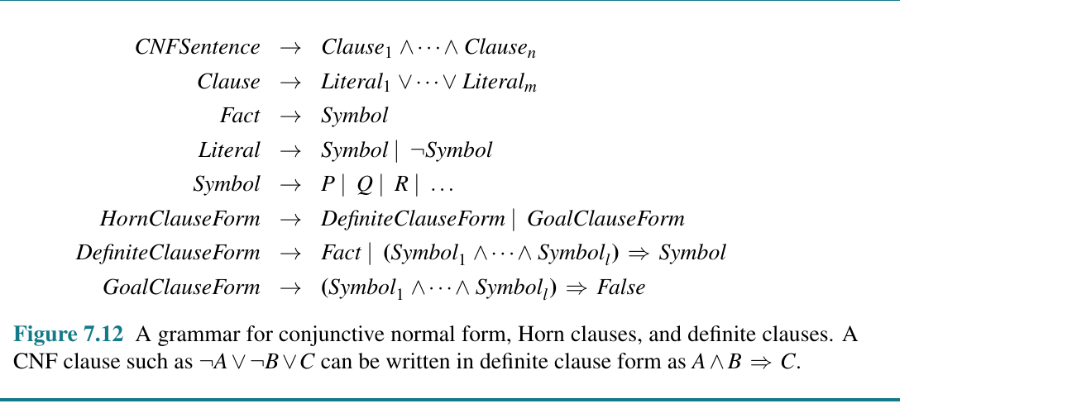
From Sentences to Clauses
Every propositional sentence can be rewritten in conjunctive normal form.
Literal — a symbol, or a negated symbol.
Clause — a disjunction of literals.
CNF sentence — a conjunction of clauses.
The rewriting is an equivalence: nothing is lost.
Why bother? Resolution — a single inference rule that is refutation-complete for propositional logic — needs clause form as input.
The grammar also names the two shapes of clause we care about today.
Russell & Norvig, Artificial Intelligence: A Modern Approach, 4th ed. (Global Edition), Figure 7.12

Slide 4
Horn Clauses
A Horn clause is a clause with at most one positive literal.
That single restriction buys three things: clauses read as implications, chaining becomes natural, and propositional entailment becomes linear in the size of the knowledge base.
Definite clause
¬A ∨ ¬B ∨ C
≡
A ∧ B ⇒ C
Exactly one positive literal. A rule.
Fact
C
≡
True ⇒ C
A definite clause with an empty body.
Not everything is a Horn clause
P ∨ Q has two positive literals — no Horn form exists.
That is the price of tractability: Prolog cannot say “one of these, I do not know which”.
Goal clause
¬A ∨ ¬B
≡
A ∧ B ⇒ False
No positive literal. A query.

Slide 5
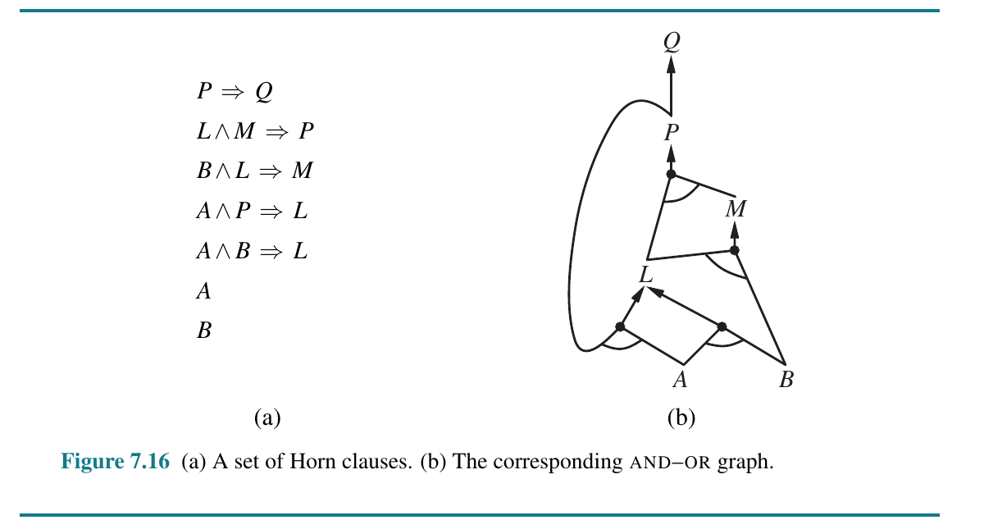
Why Horn Clauses Matter
Definite-clause knowledge bases are special for three reasons.
They read as implications. ¬L ∨ ¬B ∨ M is hard to parse; L ∧ B ⇒ M is not.
Inference is by chaining. Forward, from facts to query; backward, from query to facts.
Entailment is cheap. Linear in a propositional definite-clause KB. First-order entailment stays semi-decidable, but the search is far cheaper than full resolution.
On the right: seven Horn clauses and their AND–OR graph. Links joined by an arc are a conjunction; separate links are alternatives.
Prolog explores exactly this graph — depth first, left to right.
Russell & Norvig, Artificial Intelligence: A Modern Approach, 4th ed. (Global Edition), Figure 7.16

Slide 6
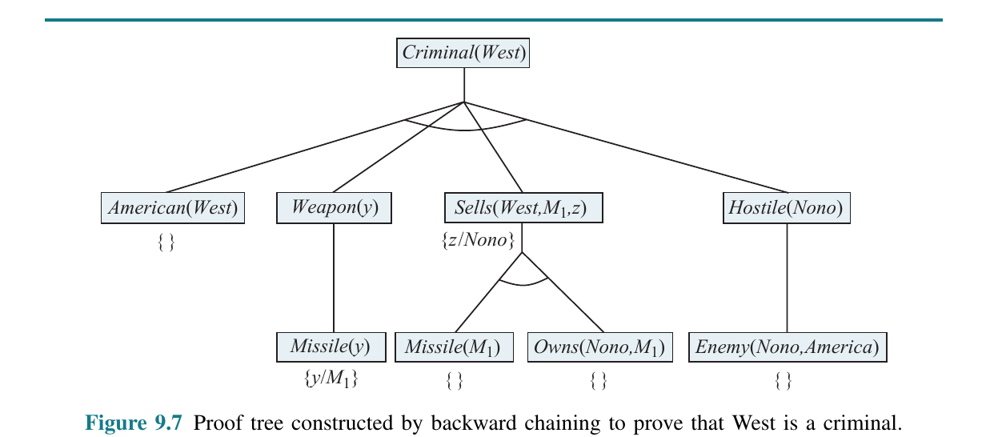
Backward Chaining
Proof tree built by backward chaining for Criminal(West). Russell & Norvig, 4th ed. (Global Edition), Figure 9.7
From the query, prove the body of any matching clause; recurse to the facts, depth first, left to right.
Only facts relevant to the query are touched, and space is linear in the size of the proof.

Slide 7
From First-Order Logic to Prolog
The same rule, twice
Prolog is first-order definite clauses in a different surface syntax. Four conventions are all you need.
The implication is written backwards. A ∧ B ⇒ C becomes C :- A, B.
Case is inverted. Uppercase is a variable, lowercase a constant — the opposite of the textbook.
Quantifiers are implicit. Every variable is universally quantified.
Punctuation matters. Comma is “and”, semicolon is “or”, and every clause ends with a period.
First-order logic
∀x,y,z American(x) ∧ Weapon(y) ∧ Sells(x,y,z) ∧ Hostile(z) ⇒ Criminal(x)
Prolog
criminal(X) :- american(X),
weapon(Y),
sells(X, Y, Z),
hostile(Z).
weapon(X) :- missile(X).
hostile(X) :- enemy(X, america).
sells(west, X, nono) :-
missile(X), owns(nono, X).
american(west). missile(m1).
owns(nono, m1). enemy(nono, america).
?- criminal(west). true.

Slide 8

What Is Prolog?
Prolog — programmation en logique — is the most widely used logic programming language.
Born in Marseille in 1972 (Alain Colmerauer and Philippe Roussel), on theory from Robert Kowalski in Edinburgh.
You state what holds, not how to compute it. The interpreter searches for a proof; the answer is the substitution that made it work.
Still used for
Expert systems, rule engines, legal and medical reasoning.
Natural-language parsing, via definite clause grammars.
Compilers, program analysis and constraint problems.
Declarative reading
ancestor(X, Y) :- parent(X, Y).
ancestor(X, Y) :- parent(X, Z),
ancestor(Z, Y).
X is an ancestor of Y if X is a parent of Y, or a parent of some Z who is.

Slide 9
SWI-Prolog
Prolog is the language; SWI-Prolog is the implementation. Free, open source, macOS / Windows / Linux.
Developed since 1987 at the University of Amsterdam. The current stable series is 10.x; this course is written against 9.2, and the two are close.
Why this one
Readable error messages and warnings.
A real debugger: trace/0 and gtrace/0.
A large library, including library(clpfd) for finite-domain constraints.
Tabling, which fixes the infinite-loop problem we will see shortly.
SWISH: Prolog in the browser, no install at all.
Portability
ISO covers the core: terms, control, arithmetic, is/2, findall/3. Most list, aggregation and I/O predicates are library, not ISO — that is where implementations diverge.
What you get
swipl — the interactive toplevel.
swipl file.pl — load a program, then the toplevel.
swipl-win — bundled editor and console.

Slide 10
Installing SWI-Prolog
macOS
Windows
Linux
brew install swi-prolog
# or the .dmg from
# swi-prolog.org/download/stable
winget install SWI-Prolog.SWI-Prolog
# or the .exe from
# swi-prolog.org/download/stable
sudo apt install swi-prolog
# Fedora:
sudo dnf install swi-prolog
Homebrew is quickest. The .dmg also installs swipl-win.
Keep the default option that adds swipl to your PATH.
Ubuntu ships an older build; the SWI PPA has current releases.
Check that it worked
No install? Use SWISH
$ swipl --version
SWI-Prolog version 9.2.9 for arm64-darwin
swish.swi-prolog.org
Fine for the exercises, but install locally before the assignment.
Any release 9.2 or newer is fine.

Slide 11
Your First Session
$ swipl
Welcome to SWI-Prolog (threaded, 64 bits, version 9.2.9)
?- X is 2 + 3 * 4.
X = 14.
?- [user]. % type clauses straight in
|: likes(ana, prolog).
|: likes(luis, X) :- likes(ana, X).
|: ^D
true.
?- likes(luis, W).
W = prolog.
?- consult('queens.pl'). % or just: ?- [queens].
true.
?- listing(range/3). % what got loaded?
?- halt.
The two prompts
?- the toplevel wants a query.
|: Prolog is reading clauses, not queries.
Every query and every clause ends with a period. Forgetting it is the classic first error.
Reading an answer
; give me the next solution
Enter stop here
A trailing . rather than ; means no more.

Slide 12
Anatomy of a Prolog Program
family.pl
Everything is a term.
Atom ana, prolog, 'Ana María'
Number 42, 3.14
Variable starts uppercase or _: X, Qs
Compound term parent(hector, ana), [1,2,3]
% ---- facts ----------------------------
parent(hector, ana).
parent(hector, luis).
parent(ana, sofia).
parent(luis, diego).
male(hector). male(luis). male(diego).
female(ana). female(sofia).
% ---- rules ----------------------------
father(X, Y) :- parent(X, Y), male(X).
grandparent(X, Z) :-
parent(X, Y),
parent(Y, Z).
sibling(X, Y) :-
parent(P, X), parent(P, Y), X \= Y.
ancestor(X, Y) :- parent(X, Y).
ancestor(X, Y) :- parent(X, Z), ancestor(Z, Y).
Fact parent(hector, ana).
Rule father(X,Y) :- parent(X,Y), male(X).
Query ?- father(hector, Who).
Name and arity name a predicate: father/2 is not father/3.

Slide 13
Querying the Knowledge Base
?- parent(hector, ana).
true.
?- parent(hector, Who).
Who = ana ;
Who = luis.
?- grandparent(G, sofia).
G = hector ;
false. % a choicepoint survived
?- findall(D, ancestor(hector, D), Ds).
Ds = [ana, luis, sofia, diego].
?- setof(P, C^parent(P, C), Parents).
Parents = [ana, hector, luis].
?- \+ parent(sofia, _).
true. % no children recorded for sofia
One query, many answers
A predicate is a relation, not a function: the same query can succeed once per solution.
Press ; to walk through them, or collect them with findall/3.
findall vs. setof
findall/3 keeps duplicates and order; returns [] when nothing matches.
setof/3 sorts and deduplicates; fails when nothing matches. Write Var^Goal for “any Var will do”.

Slide 14

Unification
Given two terms, find the substitution that makes them identical — or fail.
It is pattern matching in both directions: neither side is the “input”.
?- f(a, Y) = f(X, b).
X = a, Y = b.
?- [H|T] = [1, 2, 3].
H = 1, T = [2, 3].
?- f(a) = g(a).
false. % different functors
?- X = f(X).
X = f(X). % cyclic: no occurs check
?- unify_with_occurs_check(X, f(X)).
false.
The rules
Atoms and numbers unify only with themselves.
A variable unifies with anything, then stays bound.
Compound terms unify if functor and arity match and the arguments unify pairwise.
No occurs check, so X = f(X) builds a cyclic term.

Slide 15
How Prolog Executes a Query
Same logic, different fate
Prolog answers by SLD resolution: depth-first backward chaining with unification.
Take the leftmost goal.
Scan the clauses in file order for a matching head.
Replace the goal by that clause’s body.
On failure, backtrack: undo bindings, try the next clause.
Succeed when no goals remain.
link(a, b). link(b, c).
% base case first: an answer comes back
path(X, Z) :- link(X, Z).
path(X, Z) :- path(X, Y), link(Y, Z).
?- path(a, c).
true. % but ; still loops
% left recursion first: no answer at all
path(X, Z) :- path(X, Y), link(Y, Z).
path(X, Z) :- link(X, Z).
?- path(a, c).
ERROR: Stack limit (1.0Gb) exceeded
So clause order and goal order change what a logically identical program does.
SLD resolution is complete; Prolog’s search rule is not. :- table path/2. fixes it.

Slide 16
Arithmetic: is/2 Is Not =/2
=/2 unifies two terms. It evaluates nothing.
is/2 evaluates the expression on its right, then unifies.
is/2 needs its right-hand variables bound already, so Prolog arithmetic runs one way only.
?- X = 3 + 4.
X = 3+4. % a term, not a number
?- X is 3 + 4.
X = 7.
?- 3 + 4 = 7.
false. % structures differ
?- 3 + 4 =:= 7.
true. % values are compared
?- X is Y + 1.
ERROR: Arguments are not sufficiently
instantiated
?- X is 2 ** 10, Y is 17 mod 5.
X = 1024, Y = 2. % ** gives an integer here
Comparison operators
=:=
arithmetic equality
=\=
arithmetic inequality
< > =< >=
note =< and >=, never <=
==
term identity
\=
not unifiable

Slide 17
Recursion I: Factorial
factorial.pl
Two clauses, not an if-then-else.
The base case is a fact: 0! = 1.
A > 0 keeps the two clauses from overlapping logically — a choicepoint still survives, as the transcript shows.
C is A - 1 must precede the recursive call: is/2 needs a bound right side.
B is A * D runs on the way back up.
factorial(0, 1).
factorial(A, B) :-
A > 0,
C is A - 1,
factorial(C, D),
B is A * D.
?- factorial(5, X).
X = 120 ;
false. % choicepoint, then no more
?- factorial(20, X).
X = 2432902008176640000.
Try it
What does ?- factorial(X, 120). do, and why?
Rewrite it with an accumulator, tail recursively.
Integers are unbounded: 20! needs no special type.

Slide 18
Recursion II: Fibonacci
fibonacci.pl — the naive version
A direct translation of the mathematical definition — and that is the problem. Each call spawns two more, so the proof tree is exponential and subgoals are re-proved endlessly.
The accumulator carries the two previous values downwards: linear time, no stack to unwind. Seed it 1, 1 to match fibo/2.
Or memoise, with :- table fibo/2..
fibo(N, Y) :- N > -1, N < 2,
Y is 1.
fibo(N, Y) :- N > 1,
C is N - 1,
D is N - 2,
fibo(C, A),
fibo(D, B),
Y is A + B.
with an accumulator
?- fibo(10, X).
X = 89 ;
false.
?- fib(30, X). % the same series
X = 1346269 ;
false.
?- time(fibo(25, _)).
% 1,092,530 inferences
fib(N, F) :- fib_(N, 1, 1, F).
fib_(0, A, _, A).
fib_(N, A, B, F) :-
N > 0, N1 is N - 1, C is A + B,
fib_(N1, B, C, F).

Slide 19
Lists
Writing them from scratch
A list is either [] or [Head|Tail]. Everything else is sugar.
[1,2,3] is [1|[2|[3|[]]]]
[H|T] = [1,2,3] binds H = 1, T = [2,3]
% membership
mymember(X, [X|_]).
mymember(X, [_|T]) :- mymember(X, T).
% concatenation
myappend([], L, L).
myappend([H|T], L, [H|R]) :-
myappend(T, L, R).
% length
mylen([], 0).
mylen([_|T], N) :-
mylen(T, N0),
N is N0 + 1.
% SWI-Prolog already provides member/2,
% append/3, length/2, nth0/3, reverse/2,
% msort/2, sum_list/2, last/2, exclude/3
Relations run backwards too
?- append(X, Y, [1,2,3]).
X = [], Y = [1,2,3] ;
X = [1], Y = [2,3] ;
X = [1,2], Y = [3] ;
X = [1,2,3], Y = [].
The clauses that append two lists also split one.

Slide 20
Example: isEven / isOdd
isEven.pl
Two mutually recursive predicates decide the parity of a list’s length; the elements are never inspected.
The warnings are real feedback: X and Y occur once each, so rename them _.
isEven([], 'true').
isEven([X|XS], Y) :- isOdd(XS, Y).
isOdd([], 'false').
isOdd([Y|YS], Z) :- isEven(YS, Z).
isEven([_|XS], Y) :- isOdd(XS, Y).
isOdd([_|YS], Z) :- isEven(YS, Z).
?- isEven([a,b,c,d], X).
X = true.
?- isEven([a,b,c], X).
X = false.
More idiomatic
Returning the atoms true/false is Java thinking. Here, succeeding is the answer:
Warning: isEven.pl:2:
Warning: Singleton variables: [X]
Warning: isEven.pl:5:
Warning: Singleton variables: [Y]
even_length([]).
even_length([_|T]) :- odd_length(T).
odd_length([_|T]) :- even_length(T).

Slide 21
Example: isPerm — and a Bug
isPerm.pl
isPerm checks that every element of each list occurs in the other. That is set equality, not permutation.
With duplicates the two come apart: [1,1,2] and [1,2,2] hold the same elements but are not rearrangements of one another.
Nothing forces the lists to have the same length, either.
isPerm(X, Y) :- isInc(X, Y), isInc(Y, X).
isInc([], _).
isInc([X|XS], Y) :- isMember(X, Y),
isInc(XS, Y).
isMember(X, [X|_]).
isMember(X, [_|XS]) :- isMember(X, XS).
?- isPerm([1,2,3], [3,1,2]).
true.
?- isPerm([1,1,2], [1,2,2]).
true. % <-- but this is wrong
Two ways to fix it
is_perm(X, Y) :- msort(X, S), msort(Y, S).
?- permutation([1,1,2], [1,2,2]).
false. % the built-in gets it right
or generate and test with permutation/2.

Slide 22
Example: A Binary Search Tree
binaryTree.pl
Data structures are just terms
No class, no constructor, no allocation. A tree is the term node(K, L, R), and pattern matching takes it apart.
Terms are immutable, so insert/3 does not modify a tree: it relates an old tree to a new one that shares most of its structure.
% a tree is empty or node(Key, Left, Right)
member2(K, node(K, _, _)).
member2(K, node(N, S, _)) :- K < N, member2(K, S).
member2(K, node(N, _, T)) :- K > N, member2(K, T).
insert(N, empty, node(N, empty, empty)).
insert(N, node(K, L, R), node(K, M, R)) :-
N < K, insert(N, L, M).
insert(N, node(K, L, R), node(K, L, M)) :-
N > K, insert(N, R, M).
?- insert(5, empty, T1), insert(3, T1, T2),
insert(8, T2, T3). % T1, T2 elided
T3 = node(5, node(3, empty, empty),
node(8, empty, empty)).
?- member2(3, T3).
true.
On the original file
The version in 01_Code adds clauses for empty children. They are subsumed above: unification treats empty like any term.

Slide 23
Negation as Failure, and the Cut
\+ Goal succeeds when Prolog fails to prove Goal.
This is negation as failure, which coincides with logical negation only under the closed-world assumption: whatever is not derivable is taken to be false.
Only negate goals whose variables are already bound.
! — the cut — commits to the choices made so far in this clause.
Prolog will not retry the goals to its left, nor try any later clause of this predicate.
It buys speed but destroys the declarative reading. Prefer ( Cond -> Then ; Else ).
max(X, Y, X) :- X >= Y, !.
max(_, Y, Y).
?- max(5, 3, 3). true. % WRONG: the output
% sits in the head
max(X, Y, M) :- X >= Y, !, M = X. % right
max(_, Y, Y).
max2(X, Y, M) :- % no cut at all
( X >= Y -> M = X ; M = Y ).
?- \+ parent(sofia, _).
true.
?- \+ parent(X, ana).
false. % some X does satisfy it
?- X = sofia, \+ parent(X, _).
X = sofia. % bind first, then negate

Slide 24
Built-ins Worth Memorising
Collecting answers
Generating and choosing
Measuring and inspecting
findall(T, G, L)
between(L, H, X)
msort/2, sort/2
every solution of G, duplicates kept
X ranges over L..H on backtracking
sort; sort/2 removes duplicates
bagof / setof
select(X, L, Rest)
format("~w~n", [X])
grouped; setof sorts and dedups
pick X out of L, leaving Rest
printing you can control
aggregate_all(count, G, N)
permutation(L, P)
time(Goal)
count without building a list
every rearrangement of L
runtime and inference count
forall(C, A)
length(L, N)
listing/1, make/0
A holds for every solution of C
also builds N fresh variables
see what loaded; reload it

Slide 25
Case Study: N-Queens
queens.pl
Place N queens on an N×N board so that no two attack each other.
The representation does half the work: Qs is a permutation of 1..N: the i-th element is the column of the queen in row i.
One queen per row by construction, distinct values so one per column — only the diagonals are left to check.
queens(N, Qs) :-
range(1, N, Ns),
queens(Ns, [], Qs).
queens([], Qs, Qs).
queens(UnplacedQs, SafeQs, Qs) :-
select(Q, UnplacedQs, NewUnplaced),
\+ threat(Q, SafeQs),
queens(NewUnplaced, [Q|SafeQs], Qs).
threat(X, Xs) :- threat(X, 1, Xs).
threat(X, N, [Y|_Ys]) :-
X is Y + N ;
X is Y - N.
threat(X, N, [_Y|Ys]) :-
N1 is N + 1,
threat(X, N1, Ys).
range(M, N, [M|Ns]) :-
M < N, M1 is M + 1, range(M1, N, Ns).
range(N, N, [N]).
Reading the clauses
range/3 builds [1,2,...,N].
queens/3 carries unplaced and safe rows.
select/3 is the choice point.
threat/2 holds on a shared diagonal.

Slide 26
Running It
Printing the board
?- queens(8, Qs).
Qs = [4,2,7,3,6,8,5,1] ;
Qs = [5,2,4,7,3,8,6,1] ;
...
?- findall(Q, queens(8, Q), L), length(L, N).
N = 92.
?- aggregate_all(count, queens(6,_), C).
C = 4.
print_board(Qs) :-
length(Qs, N),
forall(member(Q, Qs), print_row(Q, N)).
print_row(Q, N) :-
forall(between(1, N, C),
( C =:= Q -> write(' Q')
; write(' .') )),
nl.
Known solution counts
N 4 5 6 7 8 9 10
sols 2 10 4 40 92 352 724
Check your own implementation against these. N = 2 and N = 3 have no solutions.
?- queens(8, Qs), print_board(Qs).
. . . Q . . . .
. Q . . . . . .
. . . . . . Q .
. . Q . . . . .
. . . . . Q . .
. . . . . . . Q
. . . . Q . . .
Q . . . . . . .

Slide 27
Generate and Test, or Test as You Go
Generate a whole board, then test it
Inferences to enumerate every solution
queens_perm(N, Qs) :-
range(1, N, Ns),
permutation(Ns, Qs),
safe(Qs).
N
generate & test
interleaved
ratio
4
425
200
2.1x
5
2,370
808
2.9x
Test while you build
6
15,358
3,090
5.0x
queens_bt(N, Qs) :-
range(1, N, Ns),
place(Ns, [], Qs).
place([], Qs, Qs).
place(Unplaced, Safe, Qs) :-
select(Q, Unplaced, Rest),
no_attack(Q, Safe, 1),
place(Rest, [Q|Safe], Qs).
7
119,997
13,587
8.8x
8
1,058,230
61,770
17.1x
9
10,426,943
296,373
35.2x
10
113,230,594
1,468,869
77.1x
SWI-Prolog 9.2.9. Your numbers will be close, not identical.
Kowalski’s equation at work.
Same logic. The second prunes a bad board sooner.

Slide 28
Debugging and Common Mistakes
trace/0 turns on the four-port debugger: every goal is reported as it is Called, Exited, Redone or Failed. notrace/0 turns it off.
The mistakes everyone makes first
A missing period. The clause merges with the next one.
= instead of is. X = 3+4 binds a term, not 7.
Singleton variable warnings. Almost always a typo, or a variable that should be _.
Left recursion. A clause that calls itself before consuming anything loops before it ever reaches a fact.
Uppercase where you meant an atom. parent(Hector, ana) says “some Hector”.
\+ on unbound variables. Bind them first.
?- trace, factorial(3, X).
Call: (10) factorial(3, _2312)
Call: (11) 3>0
Exit: (11) 3>0
Call: (11) _9956 is 3+ -1
Exit: (11) 2 is 3+ -1
Call: (11) factorial(2, _11182)
... % depths 12 and 13
Exit: (11) factorial(2, 2)
Call: (11) _78 is 3*2
Exit: (11) 6 is 3*2
Exit: (10) factorial(3, 6)
X = 6.

Slide 29
Assignment: Prolog Lab 01
1. A bigger knowledge base — 20 pts
Start from 01_Code/family.pl: at least 16 people over four generations, plus a new spouse/2. Record both parents for every child. Include a couple with three or more children, and someone with none.
2. New relationships — 35 pts
At least eight rules — mother/2, sister/2, grandmother/2, uncle/2, cousin/2, father_in_law/2 — and one recursive rule of your own that is not ancestor/2.
3. Evidence that it works — 25 pts
At least 20 plunit tests, six of them negative — one must show that nobody is their own sibling. ?- run_tests. must report that they all pass.
4. Analysis — 20 pts
Half a page. Why does sibling/2 need X \= Y? Which of your rules return the same answer twice, and why? What does the closed-world assumption claim that you never wrote down?
Testing, the Prolog way
:- begin_tests(family).
test(mother_of_ana) :-
mother(rosa, ana), !.
test(no_self_sibling, [fail]) :-
sibling(X, X).
:- end_tests(family).
?- run_tests.
% All 24 tests passed
Bonus — 10 pts
related(X, Y): is X connected to Y by any chain of parent, child or marriage links? The obvious version walks up a parent link and straight back down it, forever. Make it terminate.

Slide 30
Deliverables and Grading
What to hand in
lastname_firstname_lab01.pl — knowledge base, rules and tests in one file, one section per exercise.
lastname_firstname_lab01.pdf — two pages at most: the run_tests output and your analysis.
It must load cleanly:
Due today
23:59 — upload both files to the course platform.
Rubric
$ swipl -g true -t halt lastname_firstname_lab01.pl
Knowledge base
20
Relationship rules
35
Errors and singleton warnings cost points.
Tests, all passing
25
Written analysis
20
Invent your own family. If you used an AI assistant, say so in a header comment and state what you changed.
Bonus: related/2
+10
Total
100

Slide 31
Where to Read More
Books
Russell & Norvig, Artificial Intelligence: A Modern Approach, 4th ed. Chapter 7.5 for Horn clauses and chaining; Chapter 9.4 for backward chaining and logic programming.
Luger, AI: Structures and Strategies for Complex Problem Solving, 6th ed. Sections 14.2 and 14.3 cover Horn clause logic and Prolog.
Bratko, Prolog Programming for Artificial Intelligence, 4th ed. The standard practical book.
Sterling & Shapiro, The Art of Prolog, 2nd ed.
Online
swi-prolog.org — downloads and the full manual.
swish.swi-prolog.org — Prolog in the browser.
learnprolognow.org — free introductory course.
metalevel.at/prolog — Markus Triska on declarative Prolog and clpfd.
In this repository
01_Code/ holds every program shown today, plus family.pl.

